Slide 1
COVID-19 Data Analysis and Mapping
by Muddassir Shaikh

Slide 2
Introduction
Coronavirus disease (COVID-19) is an infectious disease caused by a new virus.
The disease causes respiratory illness (like the flu) with symptoms such as a cough, fever, and in more severe cases, difficulty breathing.
The virus is mainly spread between people during close contact, often via small droplets produced during cough, sneeze, or talk.
As of 9 April 2020, more than 1.5 million cases have been reported in more than 200 countries and territories, resulting in more than 90,000 deaths. More than 340,000 people have recovered.

Slide 3
Problem Statement
It is important to track the cases of virus and prevent it from spreading.
If you want to stay on top of the coronavirus, one great way to do so it to plot its progression over time and around the world.
So it can help WHO and govt. to keep a track of the cases and take steps to prevent it in those areas with maximum infection.

Slide 4
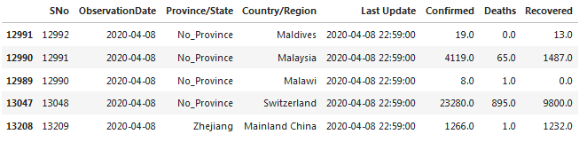
Dataframe and Analysis
The Dataset we are using is of WHO and provided by John Hopkins University. The link for the dataset is given below:
https://github.com/Muddassir98/Coursera_Capstone/blob/master/covid_19_data.csv

Slide 5
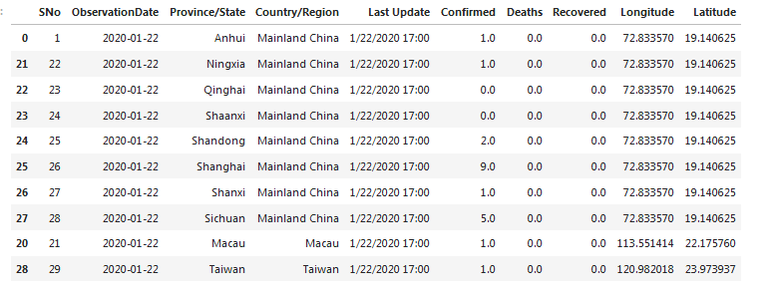
Adding Latitude and Longitude
To plot it on a map we need to get the latitude and longitude of the location. We use openstreetmap API to get latitude and longitude of each country.
The data frame now has latitude/longitude:

Slide 6
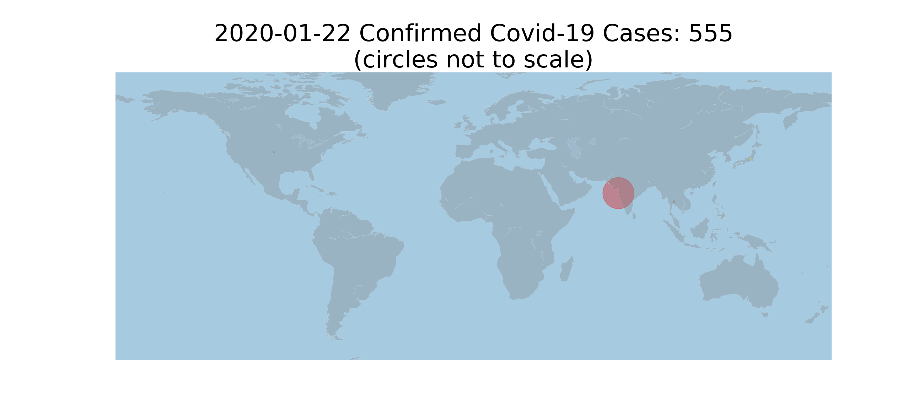
Plotting on Map & Observing
Now we use Basemap to plot infection counts by country of map.
We have programmed in such a way that we can observe the daily cases on the map, as the days pass by we can observe the increase in the no. of cases.
We start with the date 22nd January 2020 and so on:

Slide 7

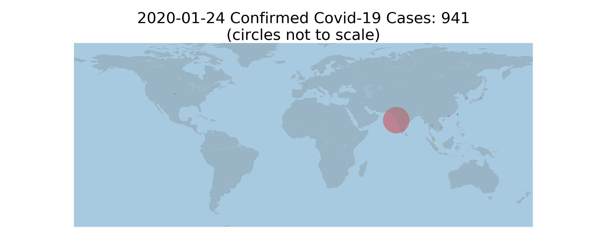

Slide 8
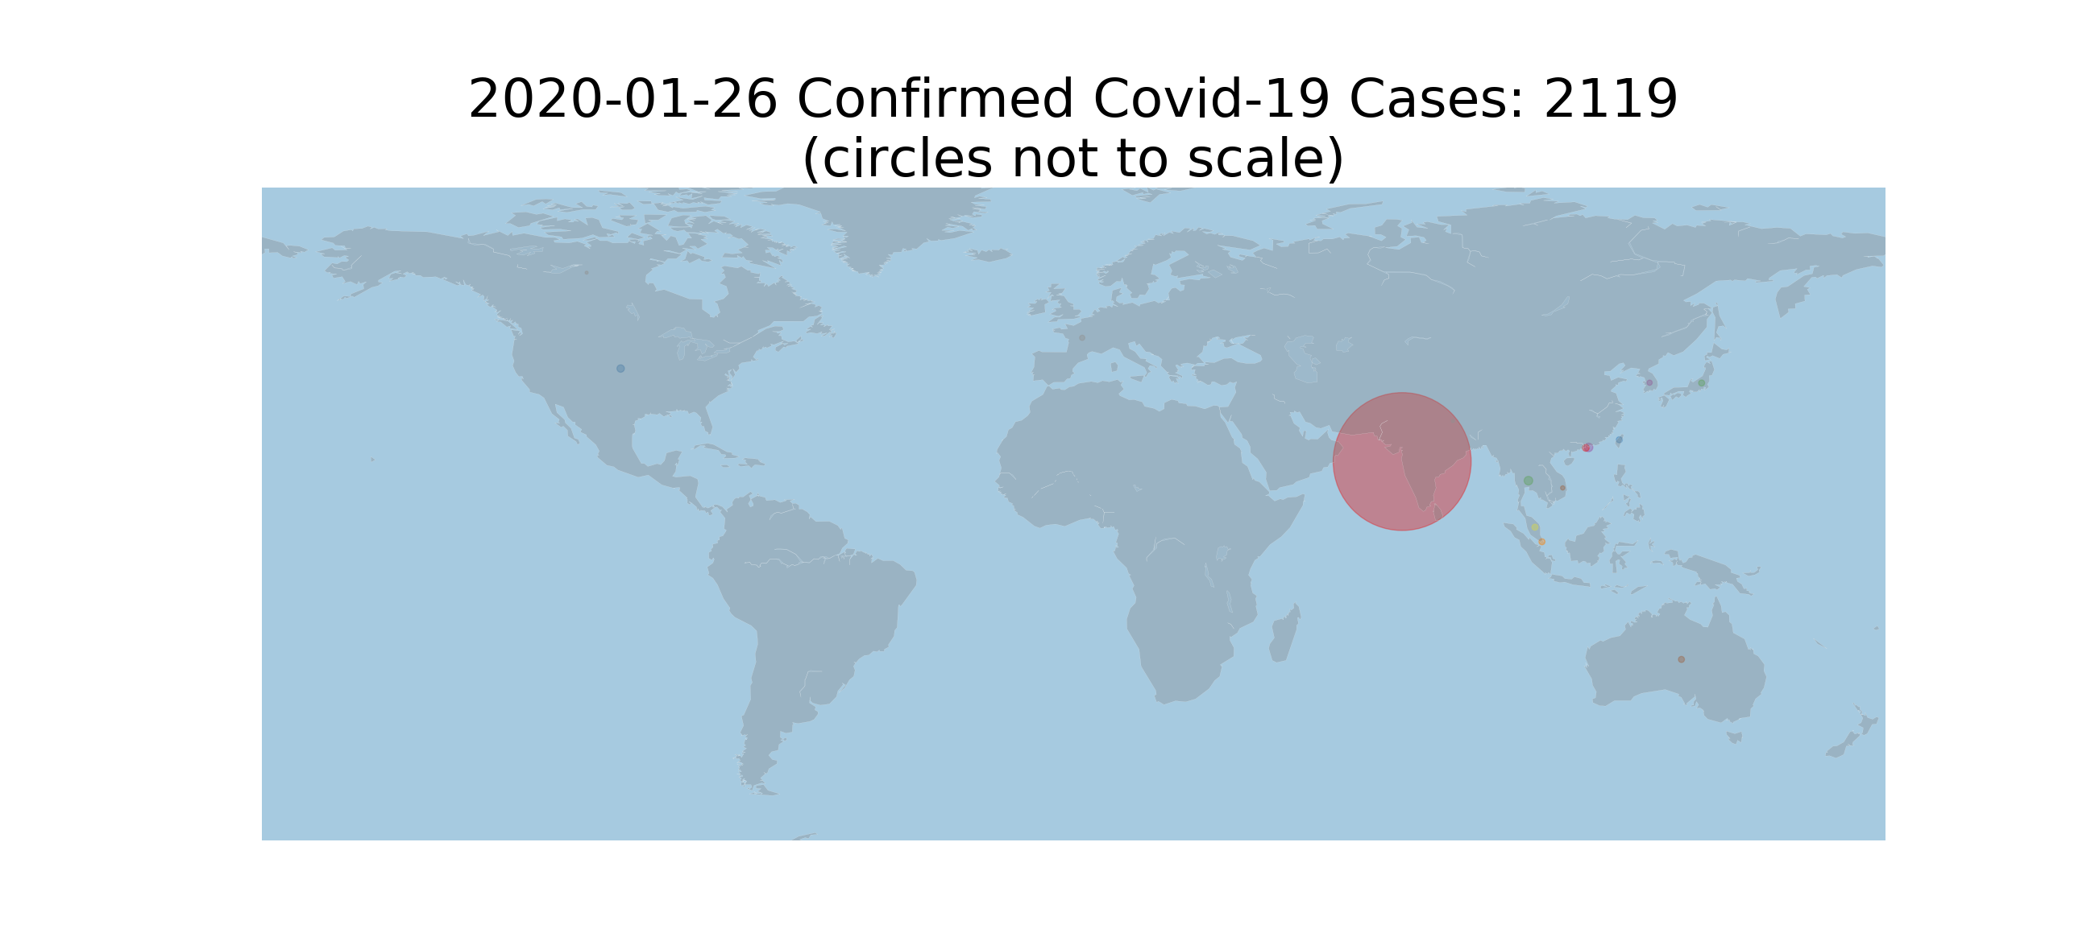
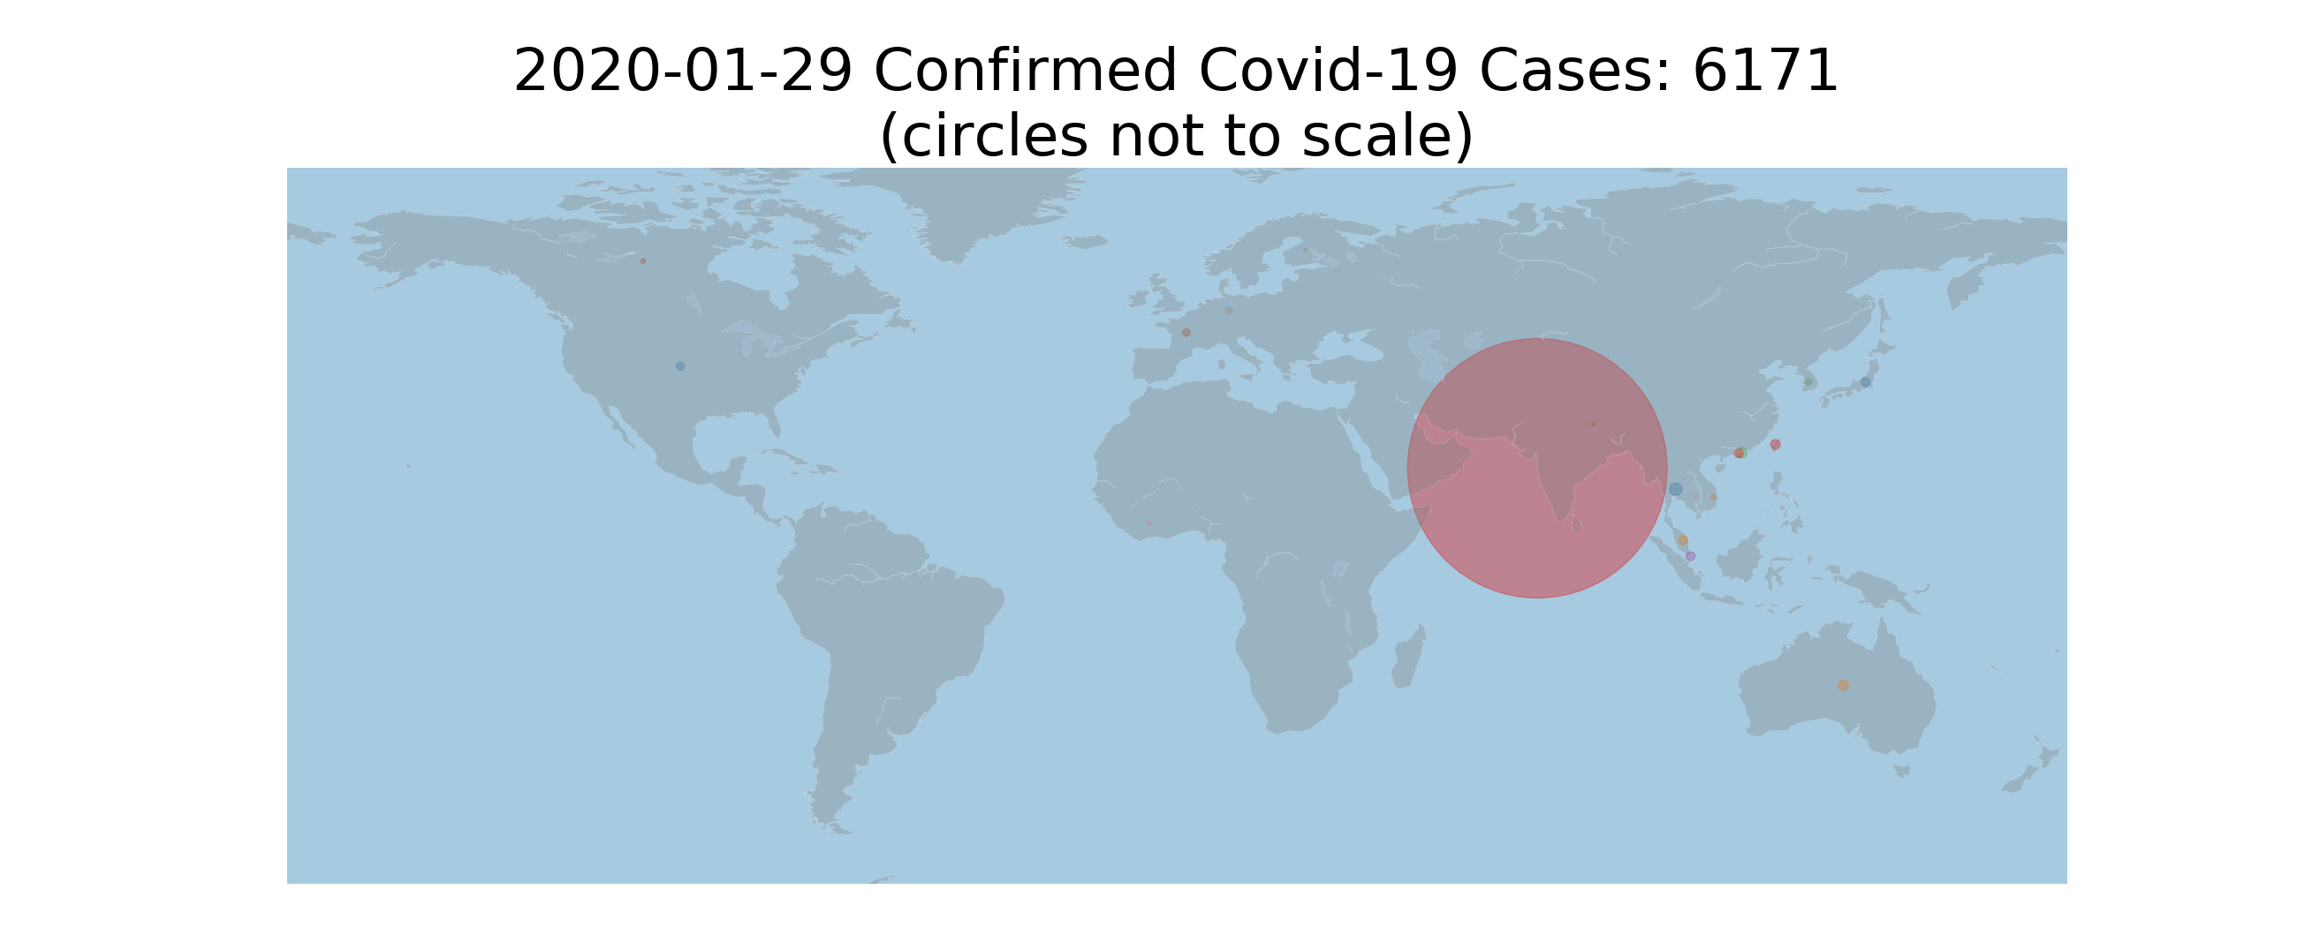

Slide 9
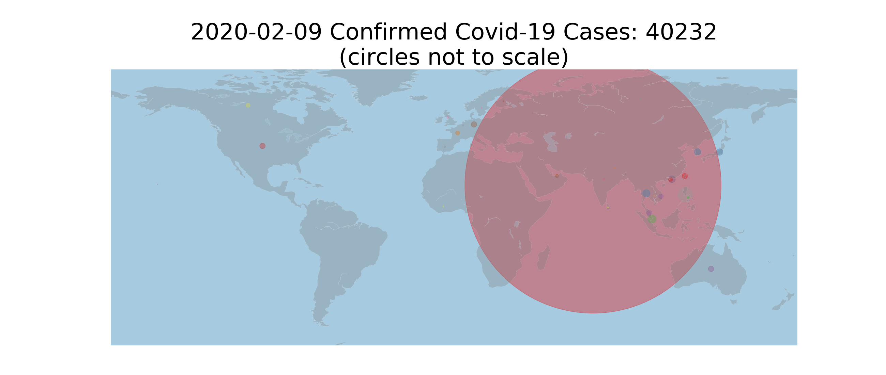
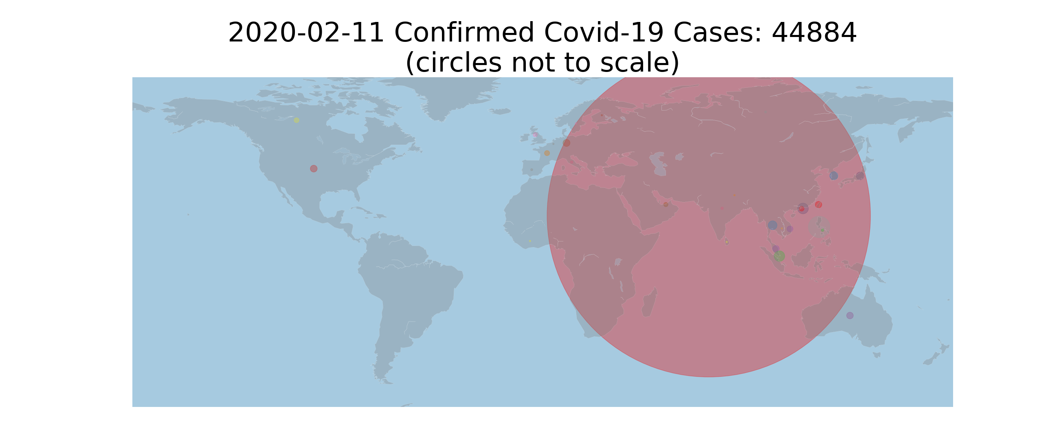

Slide 10
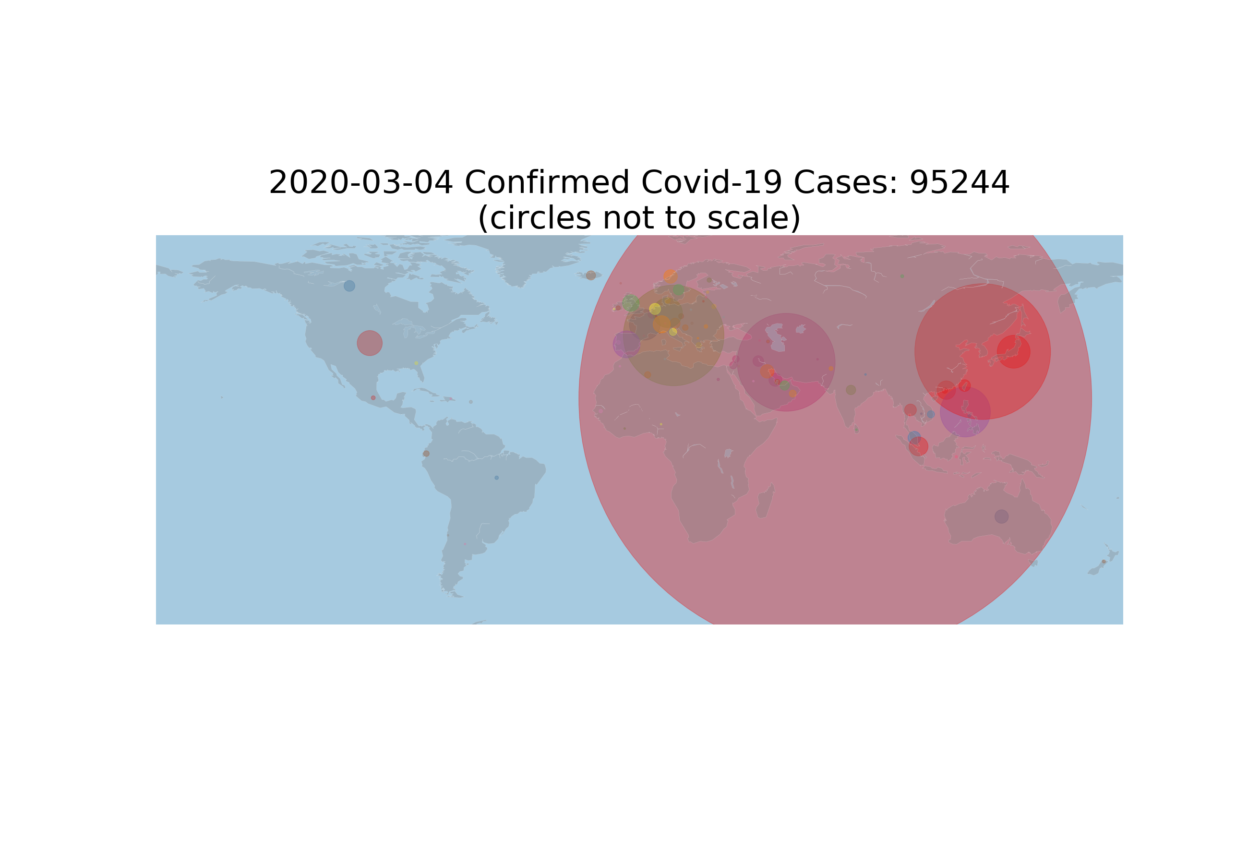
Conclusion
Thus we can observe that as the date increases the radius of circle is increasing and also new smaller circles are emerging. This shows that the COVID-19 is spreading rapidly as day pass by.
Let us now see the Map on the last date of our data frame.

Slide 11
Conclusion
The total no. of cases of COVID-19 by 4th March, 2020 had reached 95,244.
We can observe that China, Italy, Middle East countries and America have developed their own smaller circles.
This shows that they are hotspots of the corona virus and these countries should take more serious measures to stop the virus from spreading.

Slide 12
THANK YOU

